Slide 1
Unit 3: Waves Electromagnetic Spectrum
Mr. Le
Fall 2017

Slide 2
Remember!!
Electromagnetic Waves:
Are transverse waves
Can travel through a vacuum (empty space)
Can be called “radiation”

Slide 3
Electromagnetic Spectrum
Different types of electromagnetic radiations are organized on the electromagnetic spectrum according to their energy, frequency, or wavelength.
There are a total of 7 types of radiation on the spectrum.

Slide 4
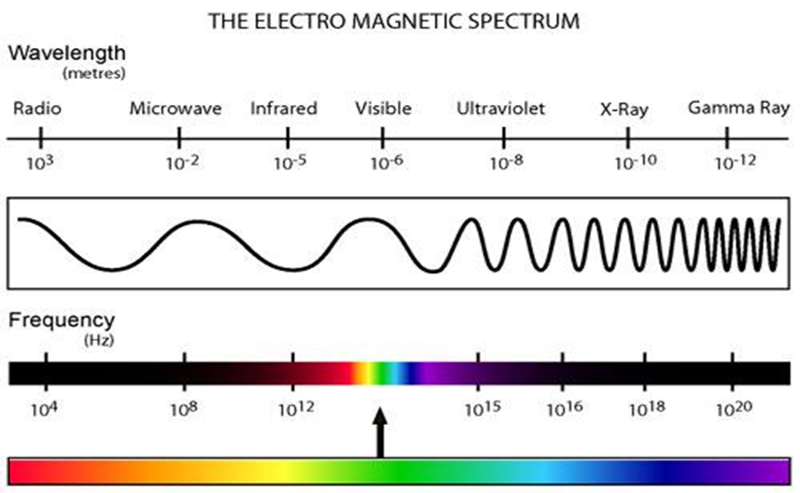
Electromagnetic Spectrum

Slide 5
DO NOT COPY THIS SLIDE
All of the slides you are about to see are missing information (mainly the uses of each type of radiation). I did this on purpose because it will be your responsibility to fill in the missing information by completing your research-based project.

Slide 6
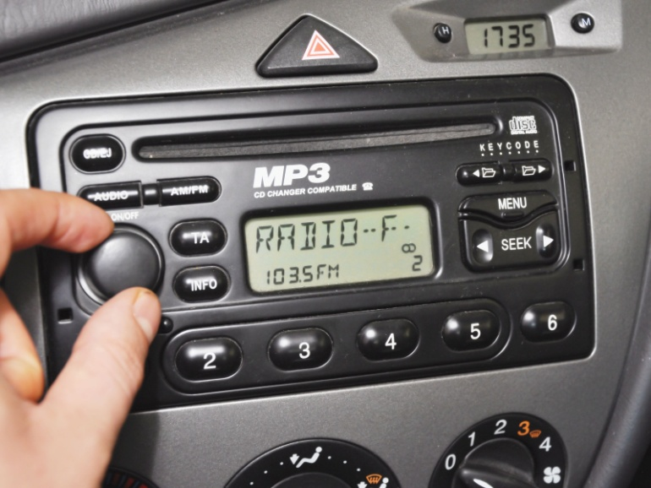
Radio Waves
Carries the least energy of any wave on the electromagnetic spectrum, but has the longest wavelength of any wave on the electromagnetic spectrum.

Slide 7
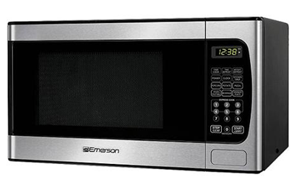
Microwaves
Microwaves are a type of radio waves
Can be used to transfer thermal energy which led to the invention of the microwave to heat food.

Slide 8
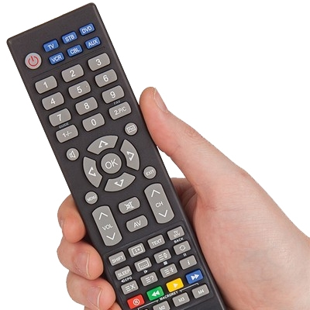
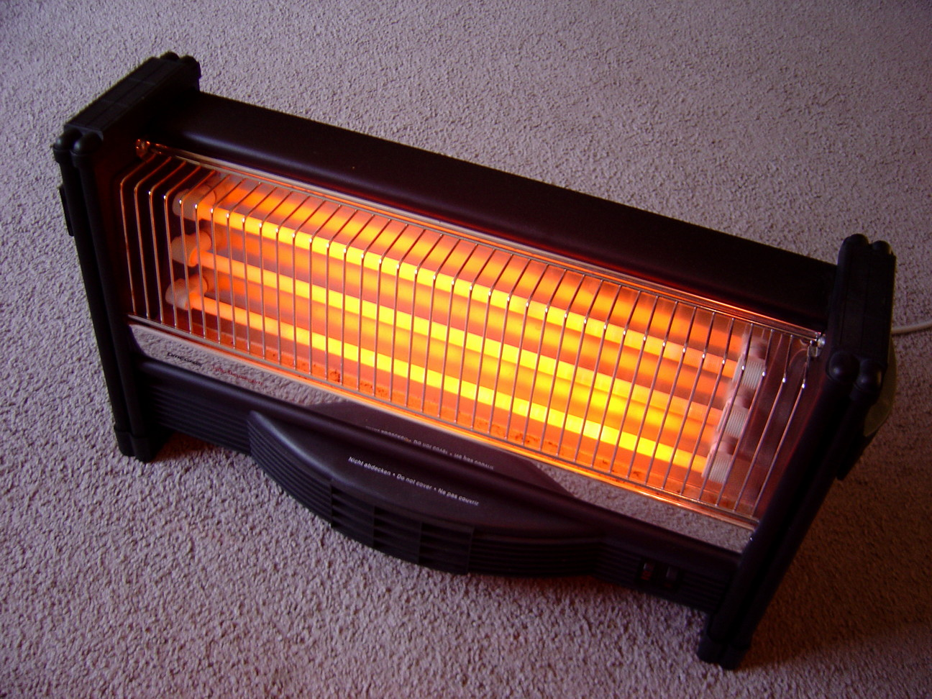
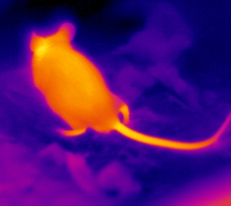
Microwaves
We experience infrared waves everyday through heat.
Some animals use infrared waves to help them find prey

Slide 9
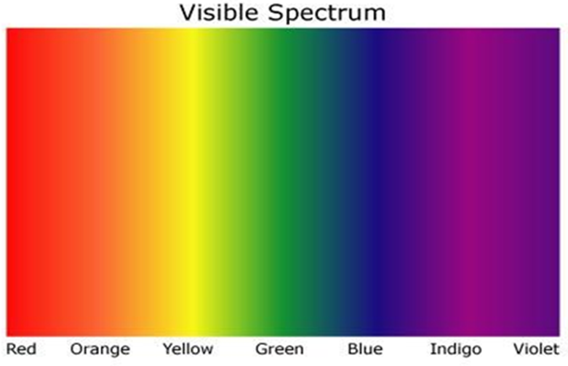
Visible Light
The only wave on the spectrum that we can see with our eyes.
We see these waves as the colors of the rainbow.

Slide 10
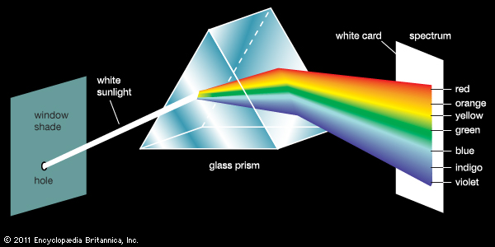
Visible Light
Together, these waves make white light.
We can use a prism to separate white light into the different colors

Slide 11
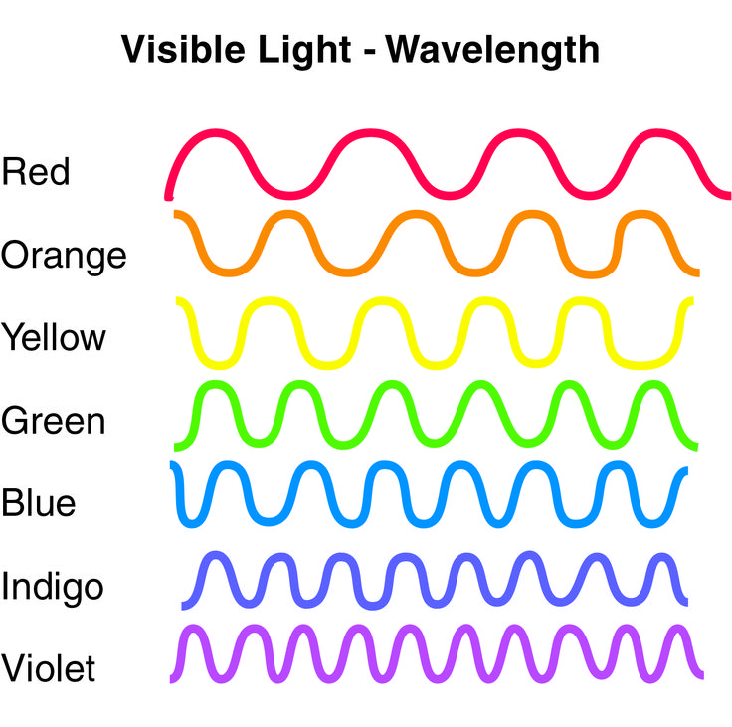
Wavelengths of Visible Light
Each color of visible light has a different wavelength.
Red has the longest wavelength and Violet has the shortest wavelength.

Slide 12
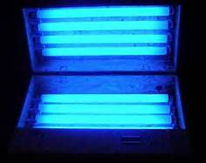
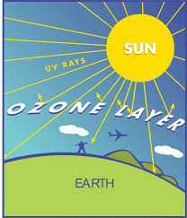
Ultraviolet Waves
The main reason why we get sunburned.
The gases in our atmosphere and the ozone layer absorbs most of the Sun’s UV radiation.
Invisible to us, but some insects can see UV rays.

Slide 13
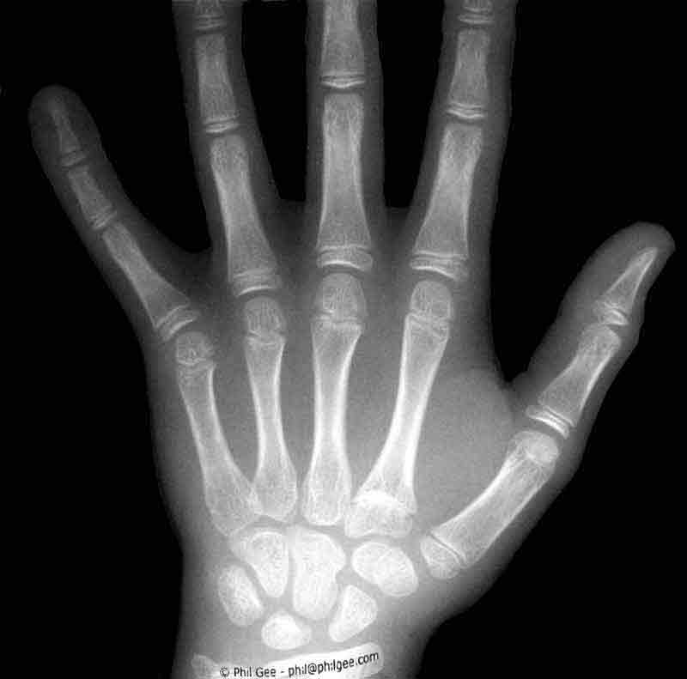
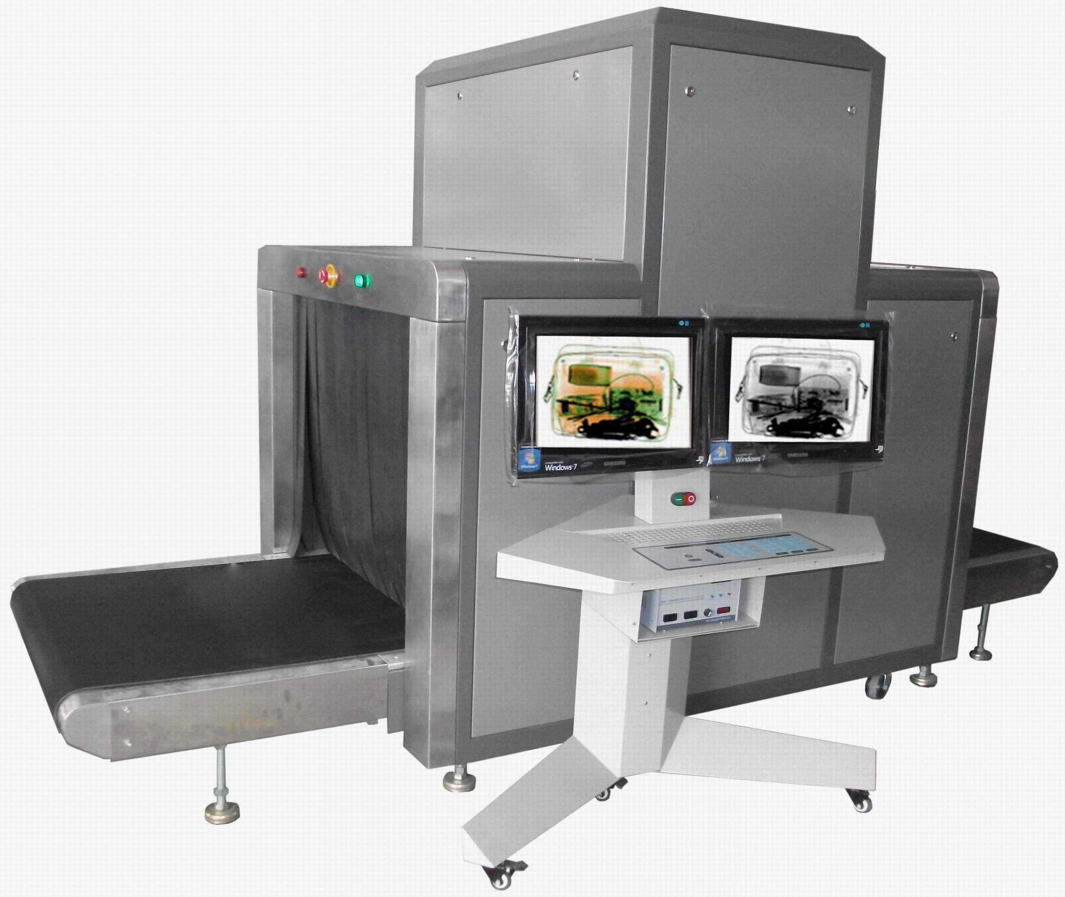
X-Rays
Can go through human tissue easily, but not bone.

Slide 14
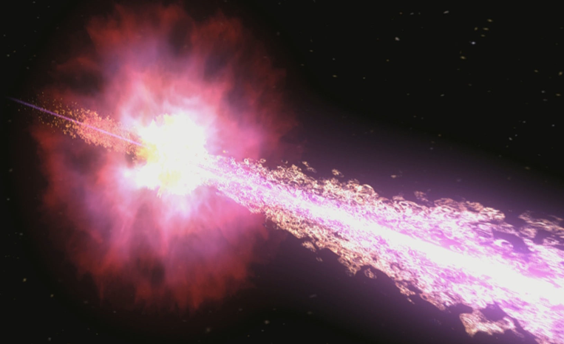
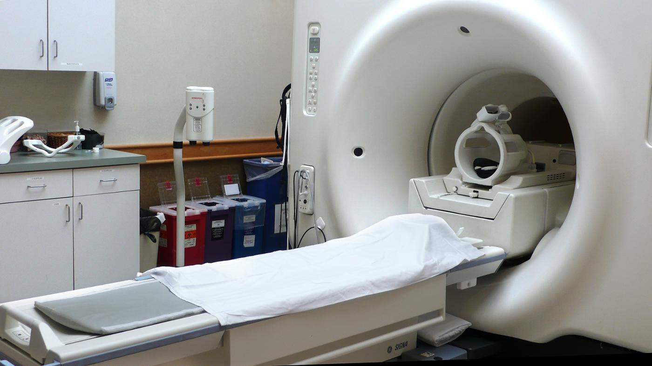
Gamma Rays
Has the highest energy of any wave on the electromagnetic spectrum
Produced from radioactive atoms and are mostly found in our universe
Can kill living cells and cause cancer

Slide 15
Mnemonic to Remember the Order
Grandma’s Gamma Ray
X-Ray X-Ray
Umbrella Ultraviolet
Visible Visible Light
In Infrared
My Microwaves
Room Radio waves

Slide 16
Mnemonic to Remember the Order
Radiowaves Read
Microwaves My
Infrared Instructions
Visible Light Visible
Ultraviolet Under
X-ray X-ray
Gamma Ray Glasses

